Slide 1
SC4002 CE4045 CZ4045 Natural Language Processing Text Normalization and Edit Distance
Dr. Sun Aixin

Slide 2

Words and Corpora
Words don’t appear out of nowhere.
In NLP, we typically work on a particular corpus (or a few corpora), to develop a system before deployment.
A corpus is a computer-readable collection of text (or speech).
A corpus is also called a text dataset or simply a dataset
Example corpus can be a collection of online reviews for mobile phones.
Another example is all articles published by Straits Times
Let’s take a sentence from a corpus
In this sentence, there 13 words if we don’t count punctuation marks as words, 15 words if we count punctuation.
Whether to tread punctuation as word, is task dependent.
Punctuation is critical for finding boundaries of things (commas, periods, colons) or for identifying some aspects of meanings (question marks, exclamation marks, quotations marks)
Singapore is most beautiful city in Asia, 11th most beautiful in the world!

Slide 3
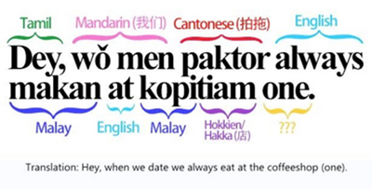
Corpora
There are many languages (Ethnologue catalog: 7097 languages for now)
NLP algorithms are most useful when they apply across many languages.
A large number of NLP algorithms are developed and tested on English.
Code switching: speakers or writers to use multiple languages in the context of a single conversation or situation.
Even all texts are in English, texts could be in different genre: news, medical reports, phone conversations.
Text also reflects demographic characteristics: age, gender, socioeconomic class
Language changes over time
Source: https://techcommunity.microsoft.com/t5/ai-customer-engineering-team/speech-recognition-for-singlish/ba-p/3580687

Slide 4
Corpora: datasheet
When developing computational models for language processing from a corpus, it’s important to consider
who produced the language, in what context, for what purpose.
A corpora datasheet specifies properties of a dataset like:
Motivation: Why was the corpus collected, by whom, and who funded it?
Situation: When and in what situation was the text written/spoken? Was the language originally spoken conversation, edited text, social media communication, monologue vs. dialogue?
Language variety: What language (including dialect/region) was the corpus in?
Speaker demographics: What was, e.g., age or gender of the authors of the text?
Collection process: How big is the data? If it is a subsample how was it sampled? Was the data collected with consent? How was the data pre-processed, and what metadata is available?
Annotation process: What are the annotations, what are the demographics of the annotators, how were they trained, how was the data annotated?
Distribution: Are there copyright or other intellectual property restrictions?

Slide 5
Lemma, Wordform, Word type, and Word token
A lemma is the base form of a set of words in general having the same stem, the same major part-of-speech, and the same word sense.
Lemma cat: cat, cats.
Lemma break: breaks, broke, broken, and breaking
The wordform is the full inflected or derived form of the word.
Inflectional: has the same word class as the original: cat → cats
Derivational: Changes of word class: care → careless, computer → computerize
For many tasks in English, wordforms are sufficient.
Word type vs word token
Types are the number of distinct words in a corpus, or the size of the vocabulary.
Tokens refer to the occurrences of the words
Types: 10
Tokens: 13
Singapore is most beautiful city in Asia, 11th most beautiful in the world!
(not counting punctuations)

Slide 6
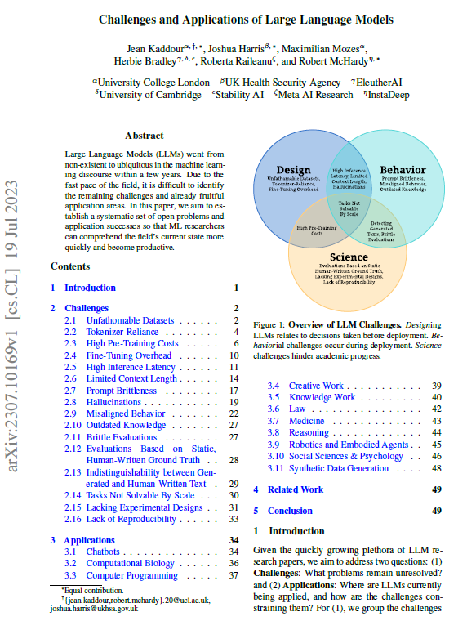
Text Normalization
Tokenizing (segmenting) words
The task of segmenting running text into words (and/or symbols)
Pretty much a prerequisite to doing anything interesting
Also called word segmentation, word tokenization, and the tool we use is often called tokenizer
Normalizing word forms
Segmenting sentences
https://arxiv.org/abs/2307.10169

Slide 7
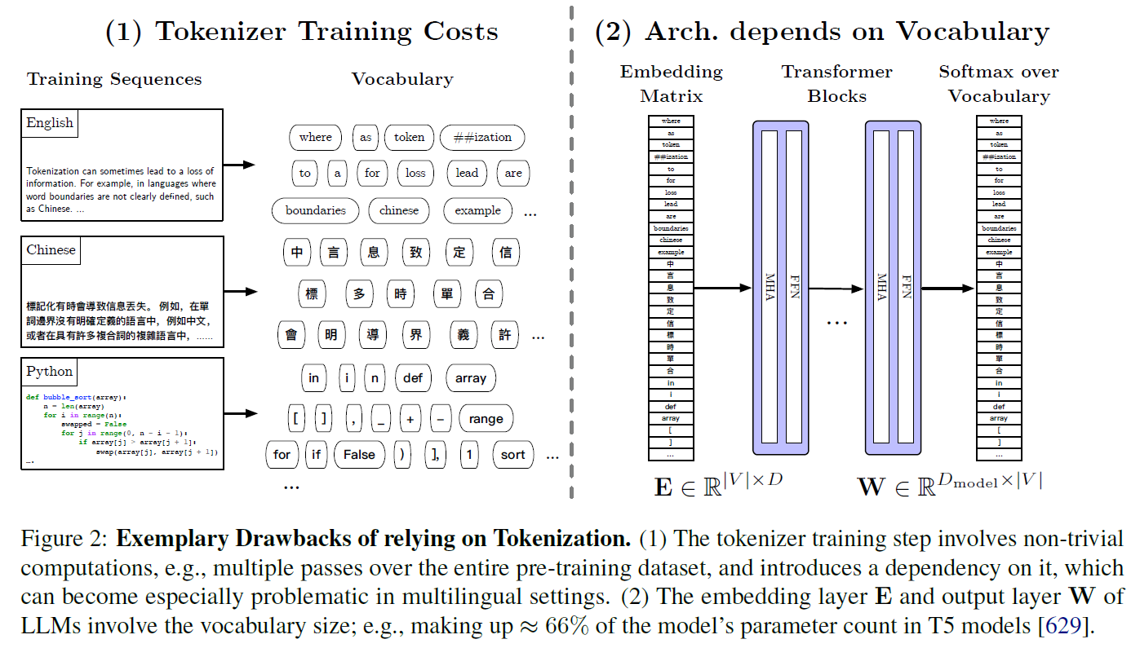
Tokenization
https://arxiv.org/abs/2307.10169

Slide 8
Tokenization
Words in English are separated by white-spaces.
Mr. Sherwood said reaction to Sea Containers’ proposal has been "very positive." In New York Stock Exchange composite trading yesterday, Sea Containers closed at $62.625, up 62.5 cents.
“I said, ‘what’re you? Crazy?’ “ said Sadowsky. “I can’t afford to do that.’’
White-space splitter gives words like:
cents.
said,
positive.”
Crazy?’

Slide 9
Tokenization: more cases
Word-internal punctuation
M.P.H. Ph.D. AT&T Google.com Yahoo!
Other Examples:
Finland’s capital → Finland? Finlands? Finland’s?
Hewlett-Packard → Hewlett and Packard as two tokens?
state-of-the-art: break up hyphenated sequence.
co-education, lowercase, lower-case, lower case?
How about names?
San Francisco: one token or two?
How do you decide it is one token? Then how about “San Francisco Airport”?
What about numbers?
3/20/91 Mar. 12, 1991 20/3/91
55 B.C., B-52, This is my number: (800) 234-2333

Slide 10
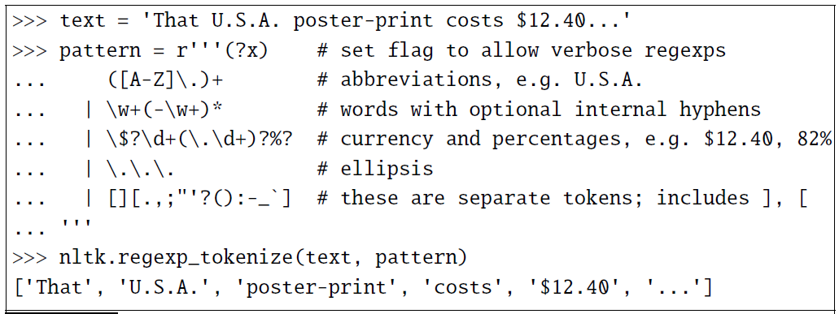
Tokenization: Implementation
Tokenization needs to be run before any other language processing,
It needs to be very fast.
Standard method for tokenization is to use deterministic algorithms based on regular expressions.
Example Python-based Natural Language Toolkit (NLTK)

Slide 11
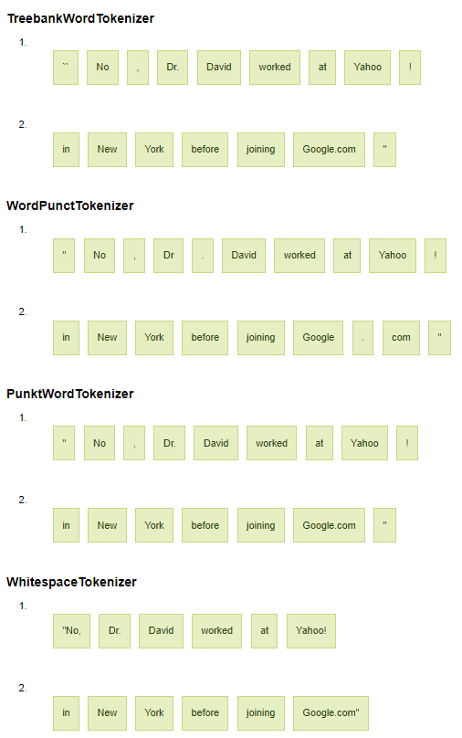
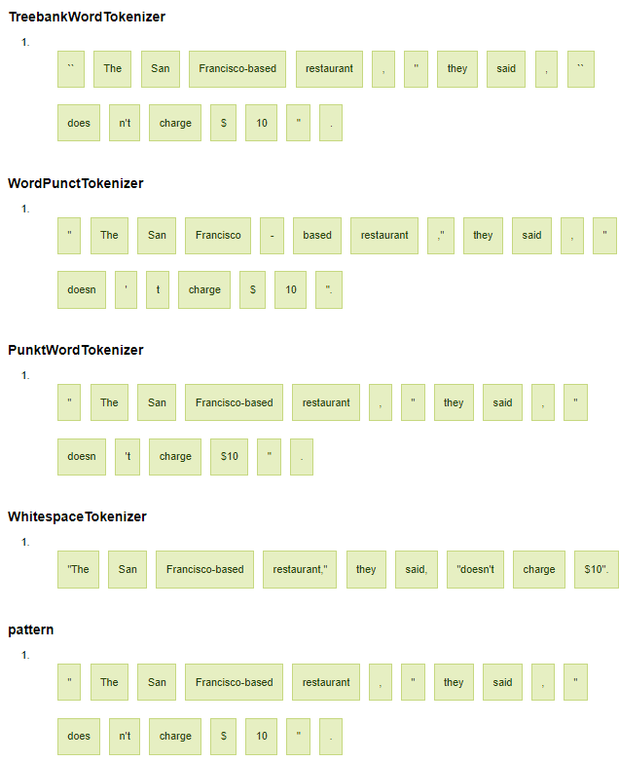
Example segmentation results

Slide 12

Specifical cases: white-spaces do not work here
URL segmentation
www.dietsthatwork.com
www.choosespain.com
Hashtag segmentation
#unitedbrokemyguitar
#manchesterunited
Hashtags allow Twitter users to track what many people (especially people whom you aren’t already following) are reporting or thinking about a particular topic or event.

Slide 13
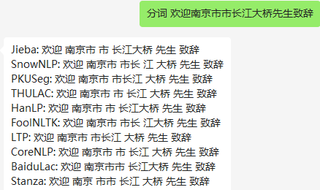
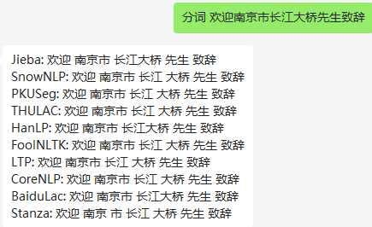
Tokenization is language dependent
Chinese words composed of characters
Average word is 2.4 characters long.
A simple segmentation algorithm based on dictionary: Maximum Matching or Maxmatch
Given a lexicon of Chinese, and a string
Start a pointer at the beginning of the string
Find the longest word in dictionary that matches the string starting at pointer
Move the pointer over the word in string
Go to 2
State-of-the-art solutions are mostly probabilistic and deep learning
http://nlpprogress.com/chinese/chinese_word_segmentation.html
https://github.com/topics/chinese-text-segmentation

Slide 14
Tokenization: language issues
German noun compounds are not segmented
Lebensversicherungsgesellschaftsangestellter
‘life insurance company employee’
Japanese is more complicated, with multiple alphabets intermingled
Arabic (or Hebrew) is basically written right to left, but with certain items like numbers written left to right
‘Algeria achieved its independence in 1962 after 132 years of French occupation.’
フォーチュン500社は情報不足のため時間あた$500K(約6,000万円)
Katakana
Hiragana
Kanji
Romaji

Slide 15
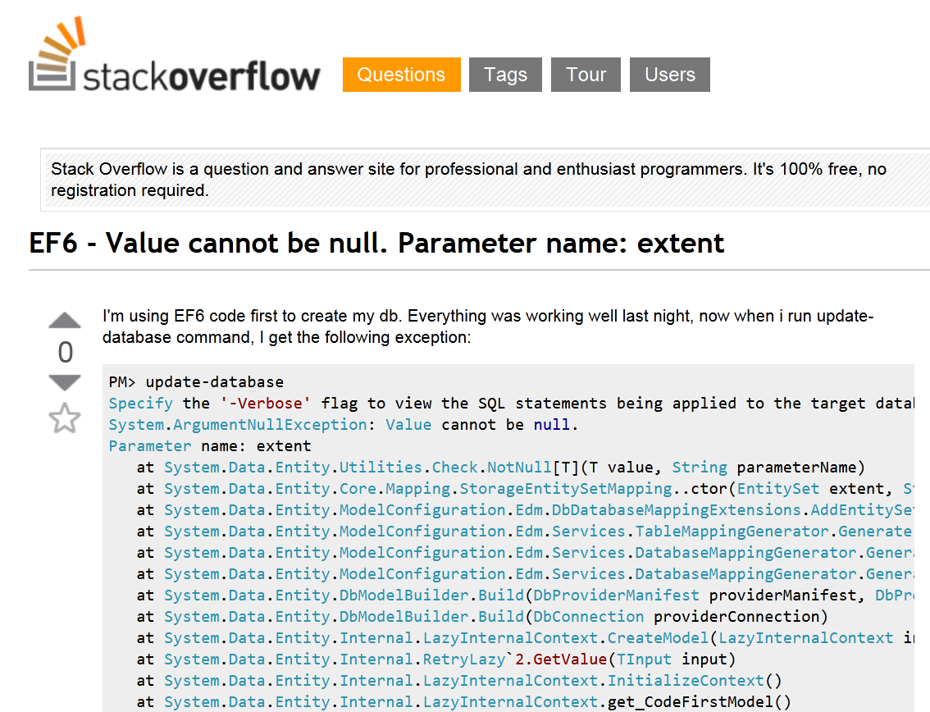
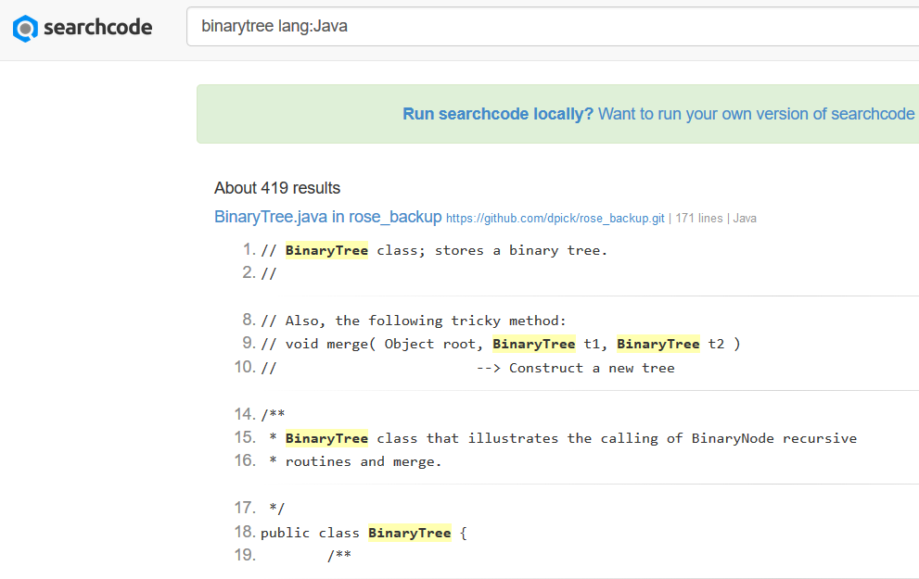
Tokenization is language dependent

Slide 16

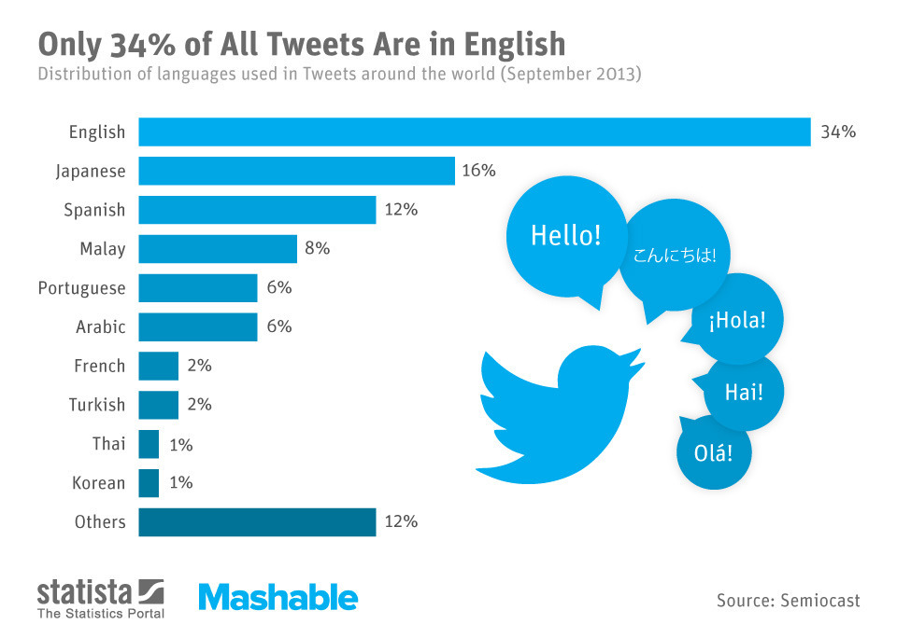
More than code switching
shd, ishould, shudd, shuld, shoud, shud, shld, sould, shouldd
http://languagetime.files.wordpress.com/2013/12/131217_twitter_sprachen_mashable_n.jpg

Slide 17
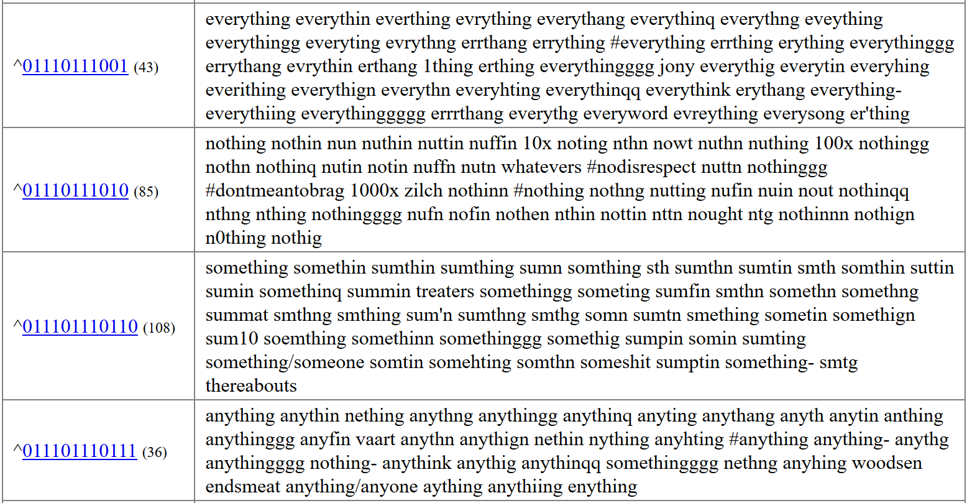
Word grouping by Brown Clustering
Source: http://www.cs.cmu.edu/~ark/TweetNLP/cluster_viewer.html

Slide 18
Text Normalization
Tokenizing (segmenting) words
The task of segmenting running text into words (and/or symbols)
Pretty much a prerequisite to doing anything interesting
Also called word segmentation, word tokenization, and the tool we use is often called tokenizer
Normalizing word forms
The task of putting words/tokens in a standard format, choosing a single normal form for words with multiple forms.
Segmenting sentences

Slide 19
Text Normalization: case folding and lemmatization
Case folding:
Mapping everything to lower case
“The” and “the” → “the”
“US” and “us” → “us”
“Fed” and “fed” → “fed”
Case folding is very helpful for generalization in many tasks, such as information retrieval or speech recognition.
Case folding is generally not done for information extraction, and machine translation.
Lemmatization
The task of determining that two words have the same root, despite their surface differences.
“am”, “are”, and “is” have the shared lemma “be”;
“dinner” and “dinners” both have the lemma dinner.
The most sophisticated methods for lemmatization involve complete morphological parsing of the word

Slide 20
Text Normalization: lemmatization
Morphology is the study of the way words are built up from smaller meaning-bearing units called morphemes.
There are two broad classes of morphemes
stems—the central morpheme of the word, supplying the main meaning
affixes—adding “additional” meanings of various kinds.
Example:
word fox consists of one morpheme (the morpheme fox)
word cats consists of two: the morpheme cat and the morpheme -s.
The most sophisticated methods for lemmatization involve complete morphological parsing of the word
A morphological parser takes a word like cats and parses it into the two morphemes cat and s.
Can be complex (and slow for some tasks)

Slide 21
Text Normalization: Stemming
Stemming: a simpler but cruder method, which mainly consists of chopping off word-final stemming affixes.
Can be considered as a naive version of morphological analysis
The resultant stem of a word may not be a valid English word (or not really the stem)
There are many stemmers and the most widely used algorithm is Porter’s stemmer
Porter’s stemmer does not need lexicon (or dictionary)
A set of rewrite rules that strip suffixes, run in series as a cascade
ING → ε (e.g., monitoring → monitor)
SSES→ SS (e.g., grasses → grass)
Example: Computerization
ization -> -ize computerize
ize -> ε computer
Code: http://tartarus.org/martin/PorterStemmer/ (in many languages)

Slide 22
Porter Stemmer: Example
Input (before stemming):
Output (after stemming):
Try out: https://textanalysisonline.com/
This was not the map we found in Billy Bones's chest, but
an accurate copy, complete in all things-names and heights
and soundings-with the single exception of the red crosses
and the written notes.
Thi wa not the map we found in Billi Bone s chest but an
accur copi complet in all thing name and height and sound
with the singl except of the red cross and the written note

Slide 23
Text Normalization
Tokenizing (segmenting) words
The task of segmenting running text into words (and/or symbols)
Pretty much a prerequisite to doing anything interesting
Also called word segmentation, word tokenization, and the tool we use is often called tokenizer
Normalizing word forms
The task of putting words/tokens in a standard format, choosing a single normal form for words with multiple forms.
Segmenting sentences
Split a paragraph or document into sentences
And sometimes more difficult: https://www.youtube.com/watch?v=-c4CNB80SRc

Slide 24
Sentence segmentation
Punctuation (like periods, question marks, and exclamation points) are the most useful cues for segmenting a text into sentences.
Question marks and exclamation points are relatively unambiguous markers of sentence boundaries, but not always true like Yahoo!
Periods are more ambiguous, e.g., Mr. or U.S.A. For this reason, sentence tokenization and word tokenization may be addressed jointly.
In the Stanford CoreNLP toolkit, sentence splitting is rule-based, a deterministic consequence of tokenization;
A sentence ends when a sentence-ending punctuation (., !, or ?) is not already grouped with other characters into a token (such as for an abbreviation or number), optionally followed by additional final quotes or brackets.
Sentence segmentation/split/tokenization can be done by machine learning models.

Slide 25
Edit Distance
Dr. Sun Aixin

Slide 26
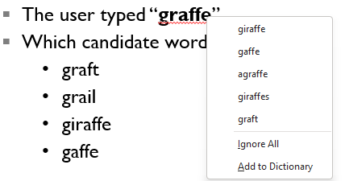
Measuring string similarity
Much of natural language processing is concerned with measuring how similar two strings are.
Example: Spelling correction
The user typed “graffe”
Which candidate word to choose?
graft
grail
giraffe
Gaffe
Example: Coreference, the task of deciding whether two strings refer to the same entity: “IBM Inc. announced today” vs “IBM profits”
Example: Evaluating machine translation and speech recognition
Spokesman confirms senior government adviser was shot
Spokesman said the senior adviser was shot dead

Slide 27
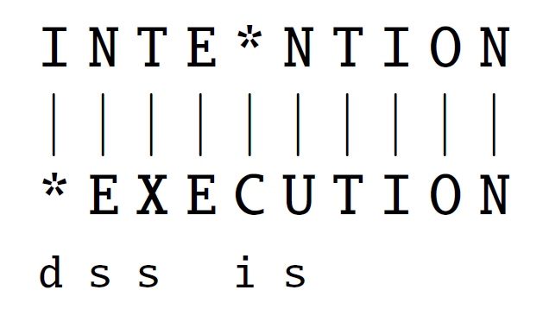
Minimum Edit Distance
The minimum edit distance between two strings is the minimum number of editing operations needed to transform one into the other
Insertion
Deletion
Substitution
Editing operations can be on letters or words depending on the application.
Example: transforming “intention” to “execution” takes 5 operations
delete an i
substitute e for n
substitute x for t
insert c
substitute u for n
Also called an alignment: a correspondence between substrings of the two sequences

Slide 28
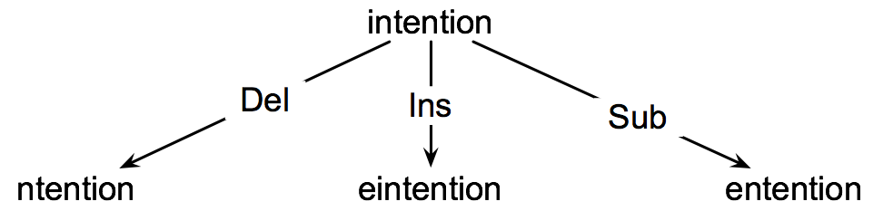
How to find the Minimum Edit Distance?
Searching for a shortest path (sequence of edits) from the start string to the final string:
Initial state: the word we’re transforming, e.g., “intention”
Operators: insert, delete, substitute
Goal state: the word we’re trying to get to, e.g., “execution”
Path cost: the number of edits
The search space of all edit sequences is huge!
Lots of distinct paths wind up at the same state.
We don’t have to keep track of all of them

Slide 29

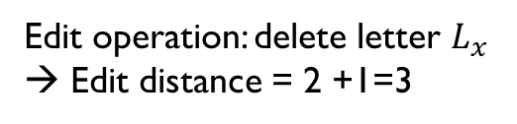
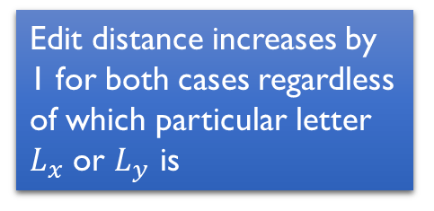
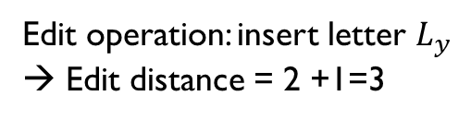

A better way to search for shortest path(s)
Assume we have computed the minimum edit distance between two words
Then
Word X
Edit distance = 2 (as an example number)
Word Y
$$L_{x}$$
Edit operation: delete letter $L_{x}$
→ Edit distance = 2 +1=3
Edit distance increases by 1 for both cases regardless of which particular letter $L_{x}$ or $L_{y}$ is
Edit operation: insert letter $L_{y}$
→ Edit distance = 2 +1=3
$$L_{y}$$

Slide 30

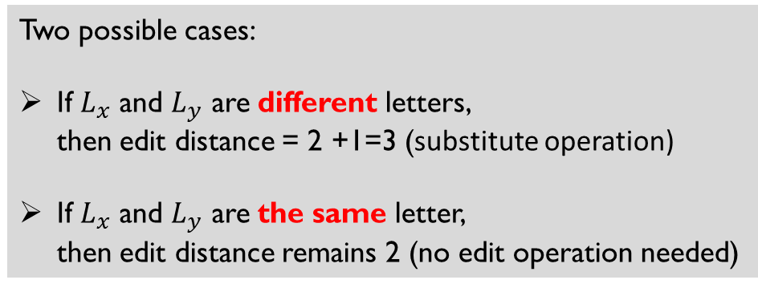
A better way to search for shortest path(s)
Assume we have computed the minimum edit distance between two words
Then
Word X
Edit distance = 2 (as an example number)
Word Y
$$L_{x}$$
Two possible cases:
If $L_{x}$ and $L_{y}$ are different letters, then edit distance = 2 +1=3 (substitute operation)
If $L_{x}$ and $L_{y}$ are the same letter, then edit distance remains 2 (no edit operation needed)
$$L_{y}$$

Slide 31
A better way to search for shortest path(s)
Then the problem becomes how to compute
Which can be computed if we know the edit distance of the 4-letter words, which can be computed if we know the ED of the 3-letter words…
Summary: if we know how to compute 1-letter words, we can compute 2, 3, … n-letter words
Word X
Word Y

Slide 32
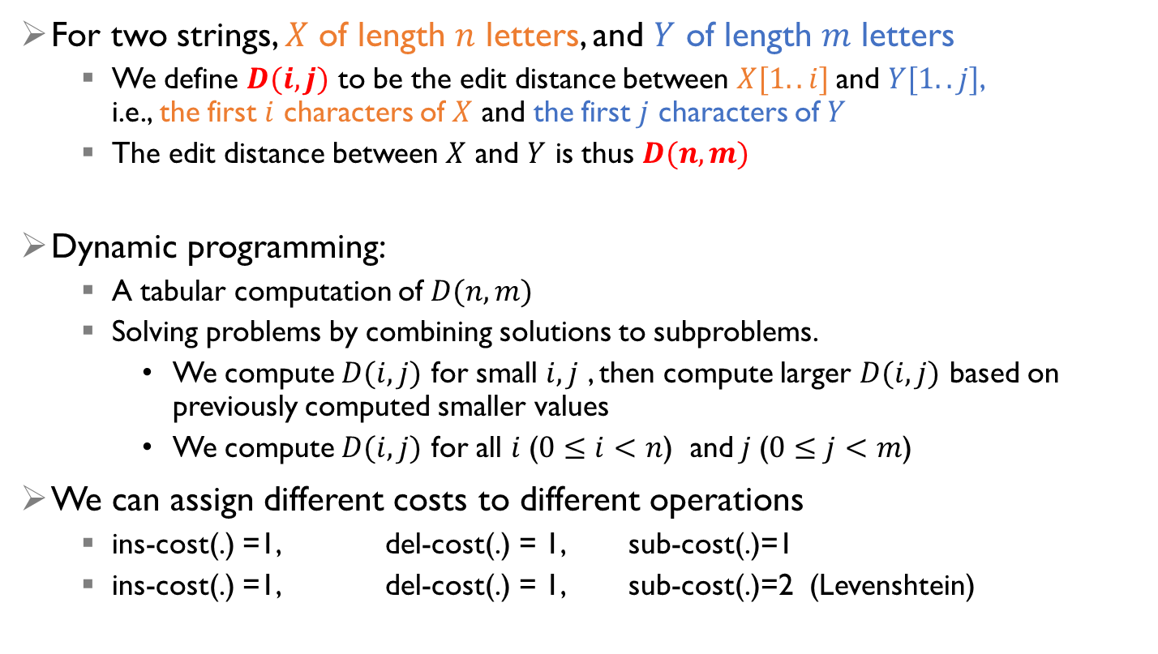
Dynamic Programming for Minimum Edit Distance
For two strings, $X$ of length $n$ letters, and $Y$ of length $m$ letters
We define $D(i,j)$ to be the edit distance between $X[1..i]$and $Y[1..j]$, i.e., the first $i$ characters of $X$ and the first $j$ characters of $Y$
The edit distance between $X$ and $Y$ is thus $D(n,m)$
Dynamic programming:
A tabular computation of $D(n,m)$
Solving problems by combining solutions to subproblems.
We compute $D(i,j)$ for small $i,j$ , then compute larger $D(i,j)$ based on previously computed smaller values
We compute $D(i,j)$ for all $i$($0≤i<n$) and$j$($0≤j<m$)
We can assign different costs to different operations
ins-cost(.) =1, del-cost(.) = 1, sub-cost(.)=1
ins-cost(.) =1, del-cost(.) = 1, sub-cost(.)=2 (Levenshtein)
Word X
Word Y

Slide 33
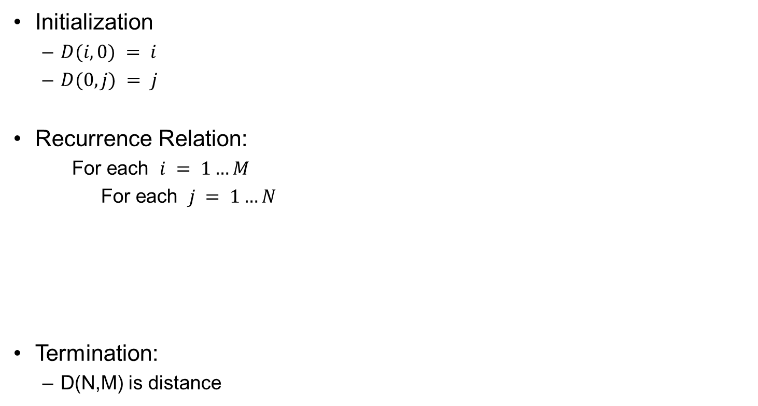
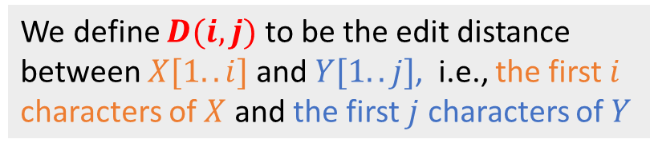
Computing Minimum Edit Distance
Initialization
$D(i,0) = i$
$D(0,j) = j$
Recurrence Relation:
For each $i = 1…M$
For each $j = 1…N$
Termination:
D(N,M) is distance
We define $D(i,j)$ to be the edit distance between $X[1..i]$and $Y[1..j]$, i.e., the first $i$ characters of $X$ and the first $j$ characters of $Y$

Slide 34
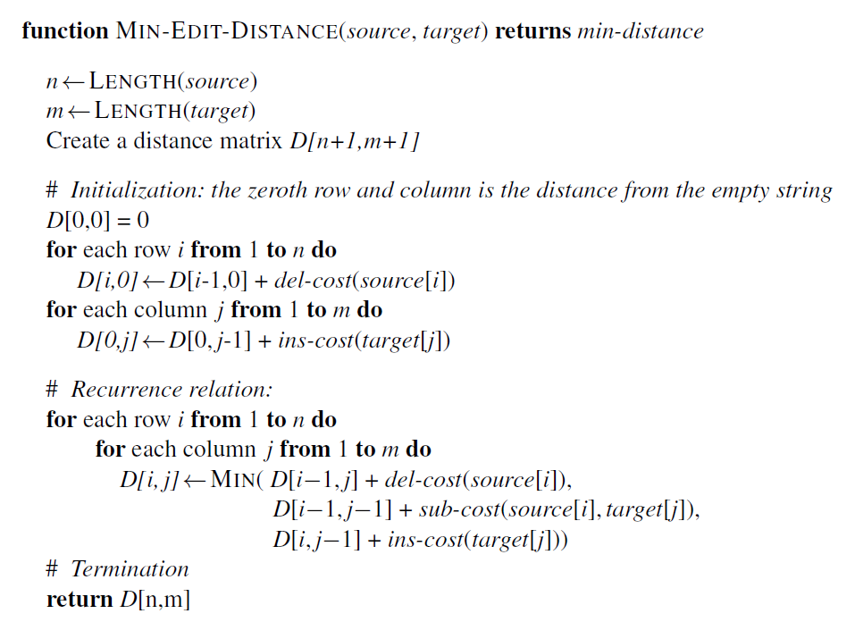
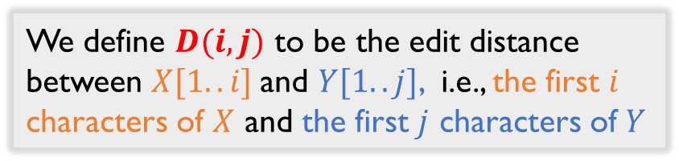
Dynamic Programming for Minimum Edit Distance
We define $D(i,j)$ to be the edit distance between $X[1..i]$and $Y[1..j]$, i.e., the first $i$ characters of $X$ and the first $j$ characters of $Y$

Slide 35
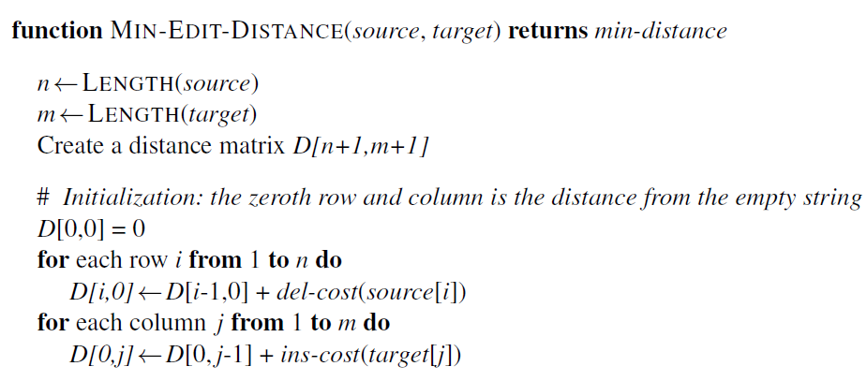
Dynamic Programming for MED: Initialization
Target
 | # | E | X | E | C | U | T | I | O | N
# | 0 | 1 | 2 | 3 | 4 | 5 | 6 | 7 | 8 | 9
I | 1
N | 2
T | 3
E | 4
N | 5
T | 6
I | 7
O | 8
N | 9
Source
intention

Slide 36
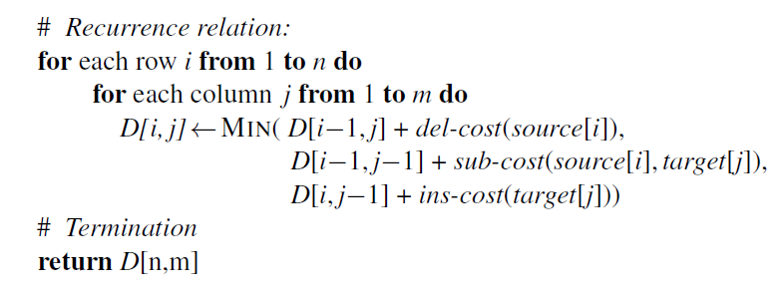
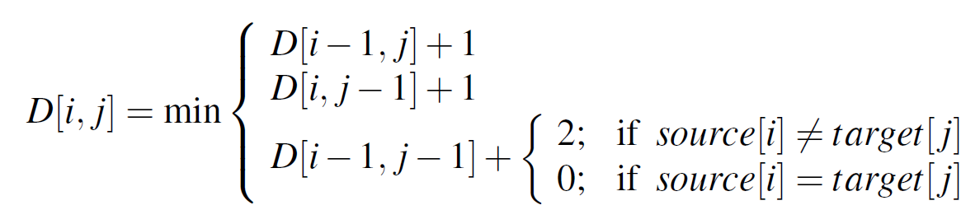
Computation
 | # | E | X | E | C | U | T | I | O | N
# | 0 | 1 | 2 | 3 | 4 | 5 | 6 | 7 | 8 | 9
I | 1 | 2
N | 2 | 3
T | 3 | 4
E | 4 | 3
N | 5 | 4
T | 6 | 5
I | 7 | 6
O | 8 | 7
N | 9 | 8
 | # | E | X | E | C | U | T | I | O | N
# | 0 | 1 | 2 | 3 | 4 | 5 | 6 | 7 | 8 | 9
I | 1 | 2 | 3
N | 2 | 3 | 4
T | 3 | 4 | 5
E | 4 | 3 | 4
N | 5 | 4 | 5
T | 6 | 5 | 6
I | 7 | 6 | 7
O | 8 | 7
N | 9 | 8

Slide 37
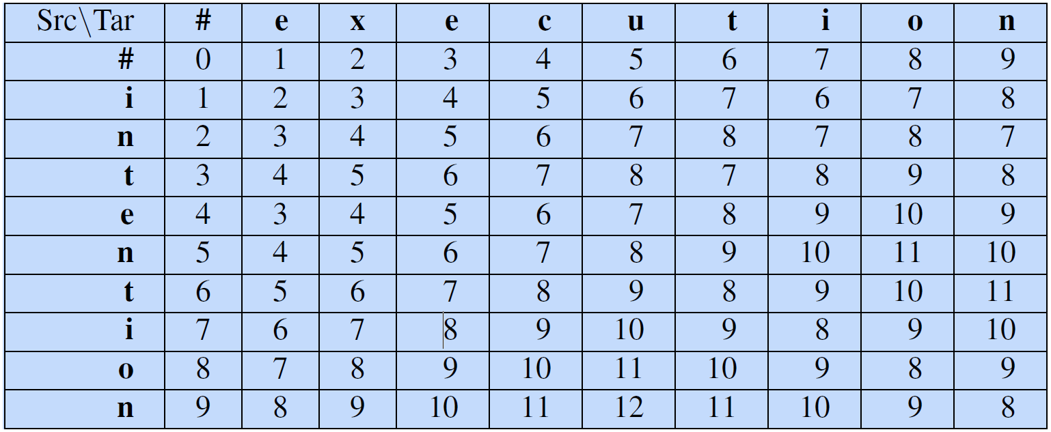
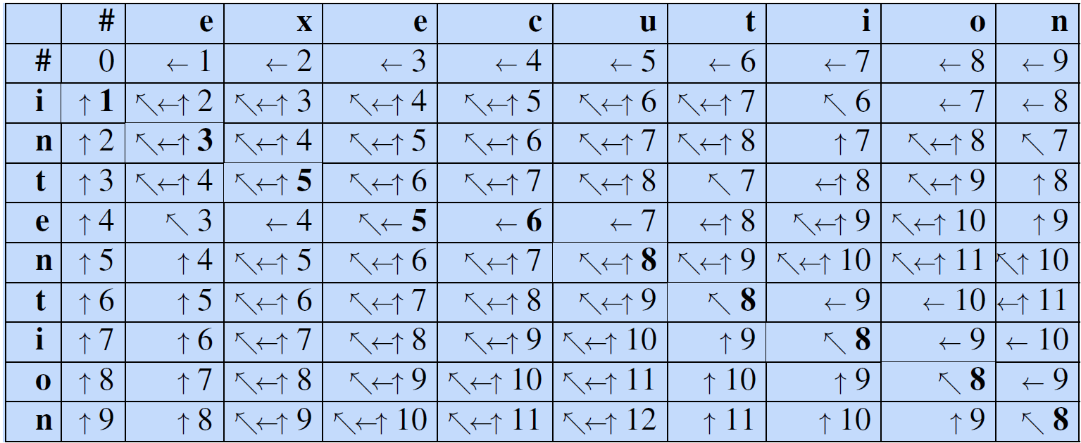
Minimum Edit Distance and Alignment
We store backpointers in each cell. The backpointer (the arrows in the cells) from a cell points to the previous cell (or cells) that we came from in entering the current cell.

Slide 38

Computing alignments
We often need to align each character of the two strings to each other
We do this by keeping “backtrace” pointers
Every time we enter a cell, remember where we came from
Some cells have multiple backpointers because the minimum extension could have come from multiple previous cells.
When we reach the end, trace back the path from the upper right corner to read off the alignment
In a backtrace, we start from the last cell, and follow the pointers back through the dynamic programming matrix.
Each complete path between the final cell and the initial cell is a minimum distance alignment.
There could be multiple paths, hence multiple alignments.

Slide 39
Summary
Words and Corpora
Datasheet specifies properties of a dataset
Words: lemma, word forms
Tokenization and normalization
Issues with tokenization
Case folding, lemmatization, stemming
Sentence segmentation
Edit distance
Applications
Algorithm
Reading: Chapter 2 https://web.stanford.edu/~jurafsky/slp3/

Slide 40
What can we do?
Given a document we are able to segment its words and sentences.
The idea of word segmentation and sentence segmentation is similar, except the unit of processing is different, i.e., word vs sentence.
Depends on the characteristics of the document, we may need to select the most appropriate tokenizers.
Given a word, we are able to perform normalization, to get the lemma or stem.
Given two words, we are able to measure the similarity or distance between them, by Edit Distance
The same idea can be applied to measure two sentences, except the unit of processing is different, i.e., character vs word

